Slide 1

Network Layer
Computer System Engineering, Fall 2018. (IPADS, SJTU)
All about routing
Yubin Xia

Slide 2
OSI, TCP/IP & Protocol Stack
7th Application Layer
Application Layer
HTTP
SMTP
POP3
FTP
…
End-to-end Layer
6th Presentation Layer
5th Session Layer
4th Transport Layer
Transport Layer
TCP
UDP
3th Network Layer
Network Layer
IP
Network Layer
ICMP
2nd Link Layer
Link Layer
ARP & RARP
Ethernet
PPP
…
Link Layer
1st Physical Layer
WiFi
Fiber
TD-LTE
FDD
…
OSI
TCP/IP
CSE

Slide 3
Network Layer

Slide 4
IP: Best-effort Network
Best-effort network
If it cannot dispatch, may discard a packet
Guaranteed-delivery network?
Also called store-and-forward network, no discarding data
Work with complete messages rather than packets
Uses disk for buffering to handle peaks
Tracks individual message to make sure none are lost
In real world
No absolute guarantee
Guaranteed-delivery: higher layer; best-effort: lower layer

Slide 5
Duplicate Packets and Suppression
Discarding packets is common case
Many network protocol includes timeout and resend mechanism
When a congested forwarder discards a packet
Client does not receive a response as quickly as originally hoped
Users may prepared for duplicate requests and responses
Detecting duplicates may or may not be important

Slide 6
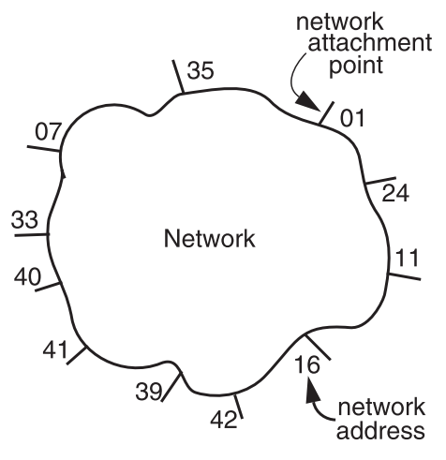
The Network Layer
Addressing interface
Network attachment points
Network address
Source & destination
NETWORK_SEND (segment_buffer, destnation, network_protocol, end_layer_protocol)
NETWORK_HANDLE (packet, network_protocol)

Slide 7


Managing the Forwarding Table: Routing
Routing (or path-finding)
Constructing the tables
Impractical by hand
Determining the best paths requires calculation
Recalculating the table when links change
Recalculating the table when link fails
Adapt according to traffic congestion
Static routing vs. adaptive routing
Adaptive routing requires exchange of info
Where are you going?

Slide 8
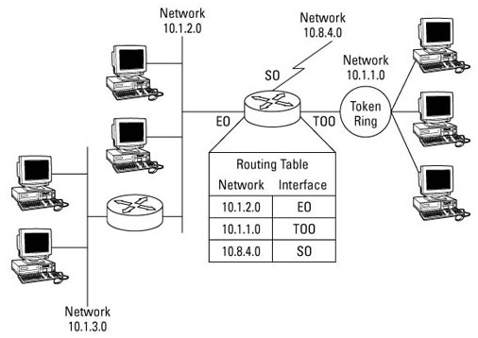

IP Route Table
Interface 1 … Interface N

Slide 9
Control-plane VS. Data-plane
Control-plane
Control the data flow by defining rules
E.g., the routing algorithm
Data-plane
The data-path which copies data according to the rules
Performance critical
E.g., the IP forwarding process
The routing table
Control-plane writes the table, data-plane reads the table

Slide 10
Routing
How to generate the routing table?

Slide 11
Goal of A Routing Protocol
Allow each switch to know, for every node dst in the network, a route to dst
Allow each switch to know, for every node dst in the network, a minimum-cost route to dst
Build a routing table at each switch, such that routing_table[dst] contains a minimum-cost route to dst

Slide 12
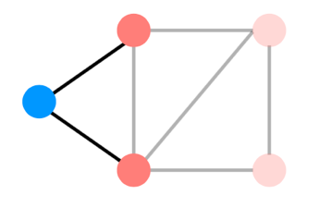
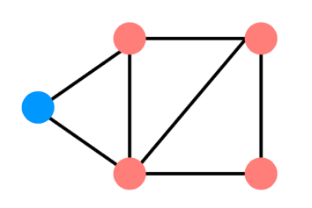
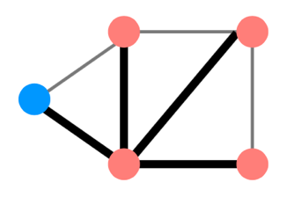
Distributed Routing: 3 Steps in General
Nodes learn about their neighbors via the HELLO protocol
Nodes learn about other reachable nodes via advertisements
Nodes determine the minimum-cost routes (of the routes they know about)

Slide 13
Two Types of Routing Protocol
Protocol 1: Link-state
Nodes advertise to everyone their costs to their neighbors
via flooding
Integrate using Dijkstra's
Protocol 2: Distance-vector
Nodes advertise to neighbors with their cost to all known nodes
Update routes via Bellman-Ford integration

Slide 14
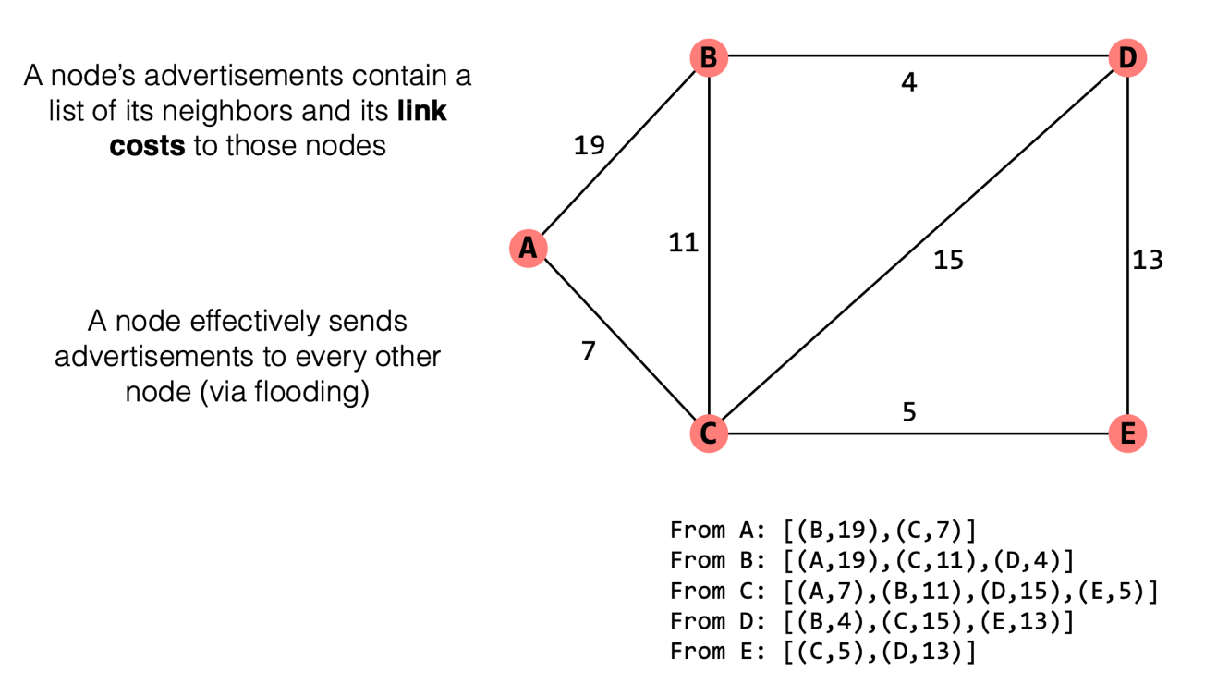
Link-state Routing

Slide 15
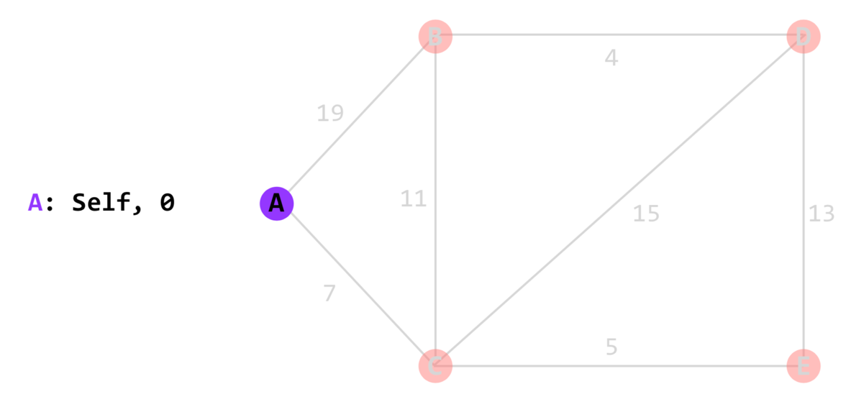
Link-state Routing

Slide 16
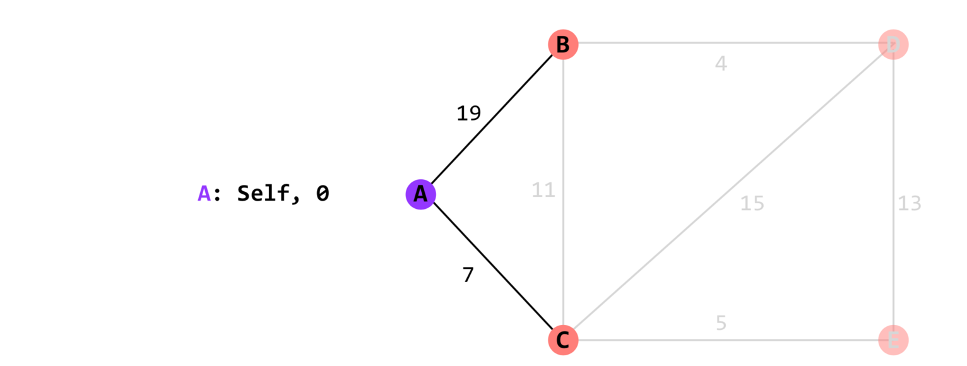
Link-state Routing

Slide 17
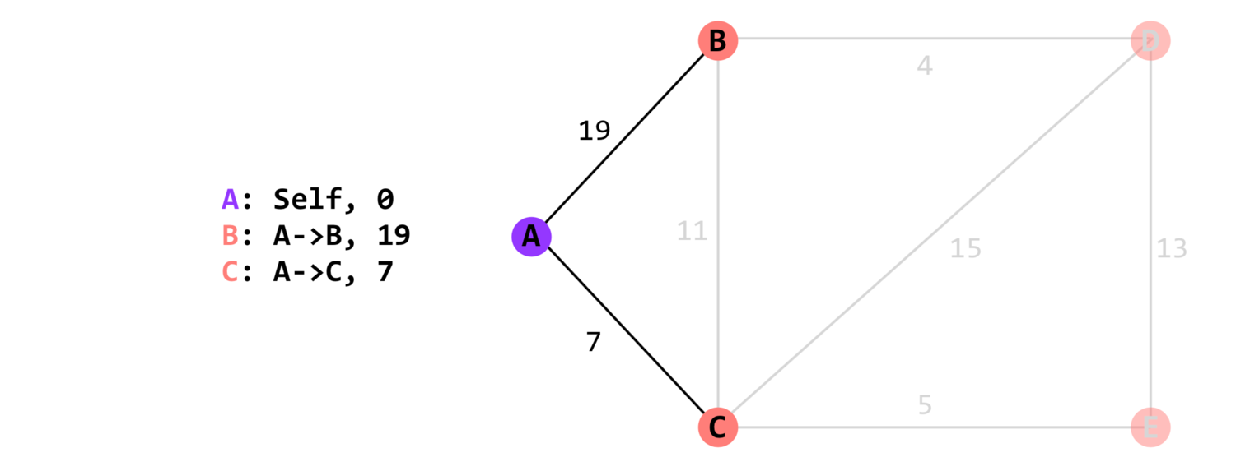
Link-state Routing

Slide 18
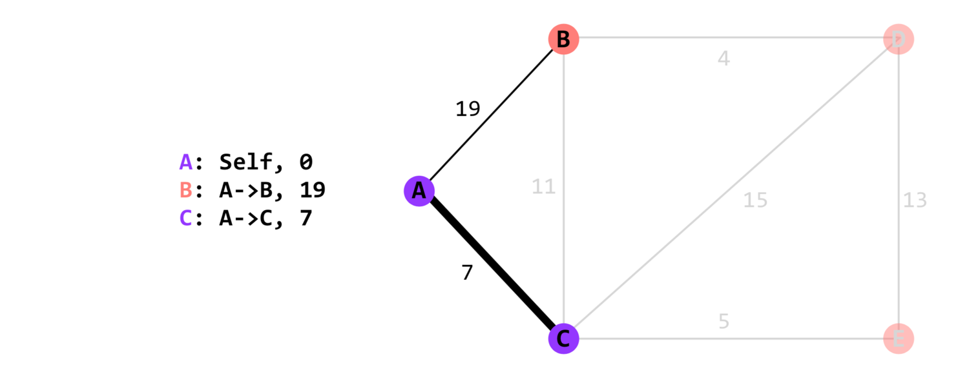
Link-state Routing

Slide 19
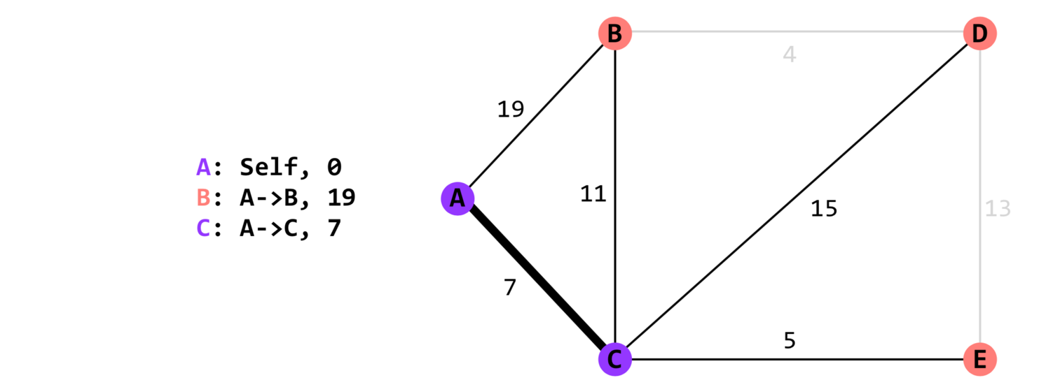
Link-state Routing

Slide 20
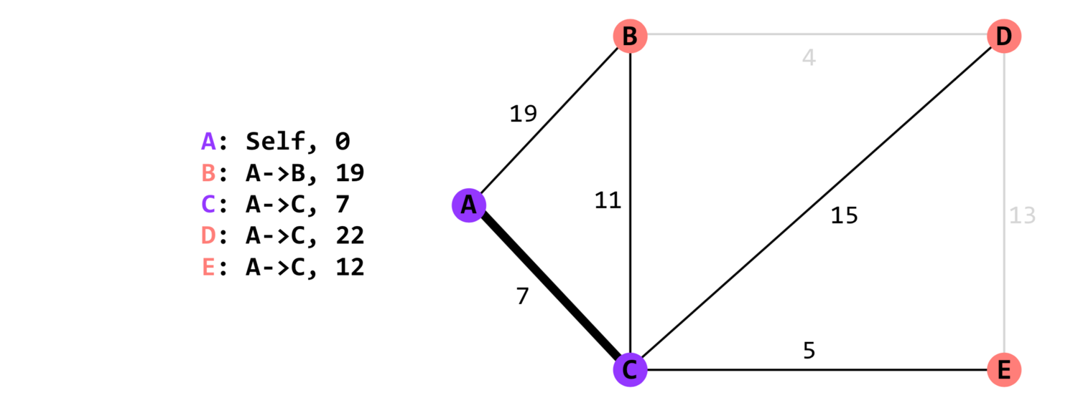
Link-state Routing

Slide 21
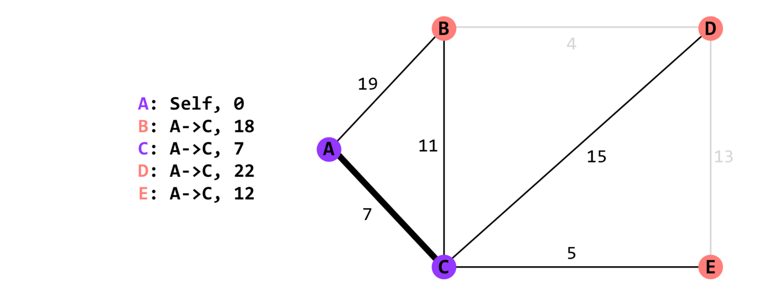
Link-state Routing

Slide 22
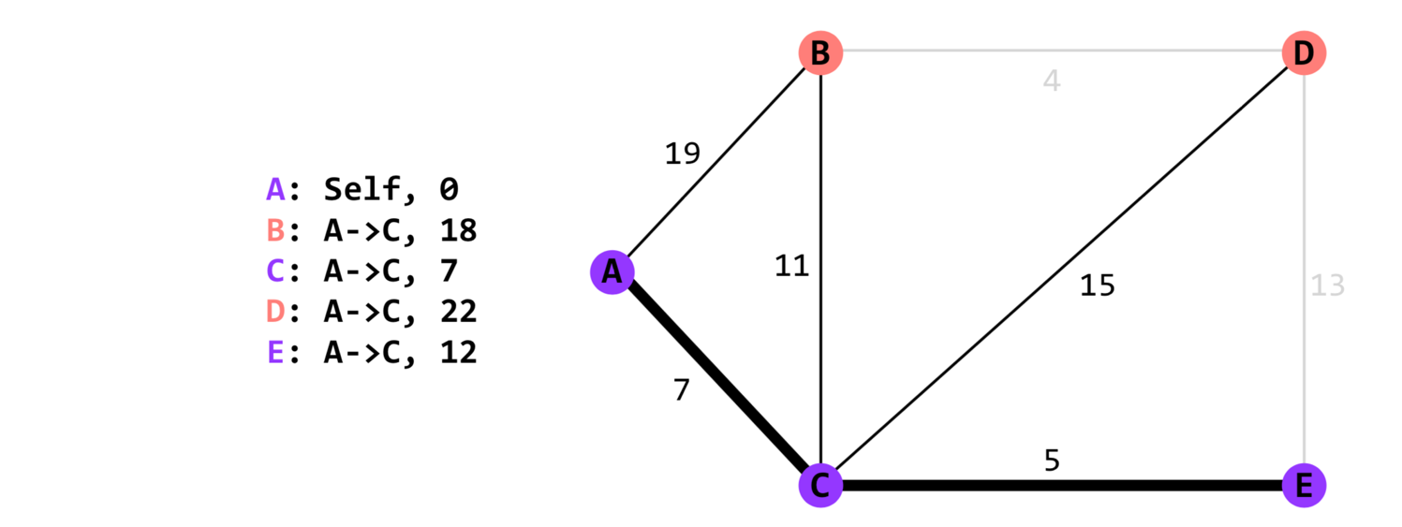
Link-state Routing

Slide 23
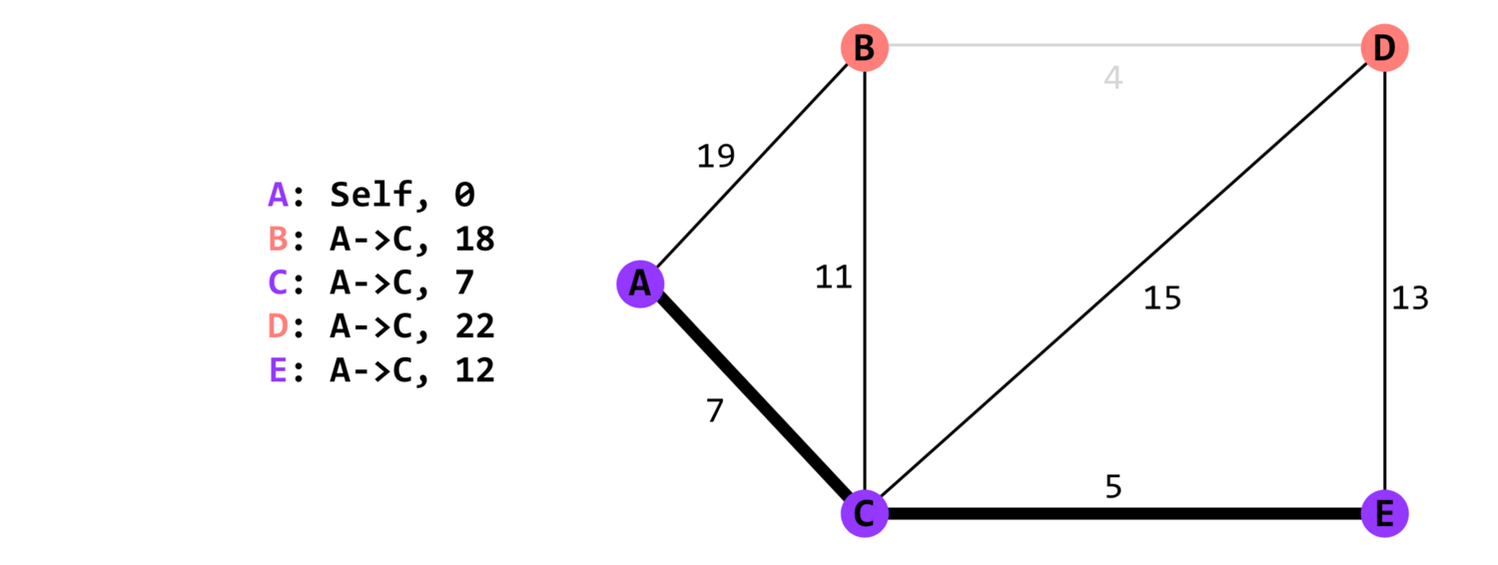
Link-state Routing

Slide 24
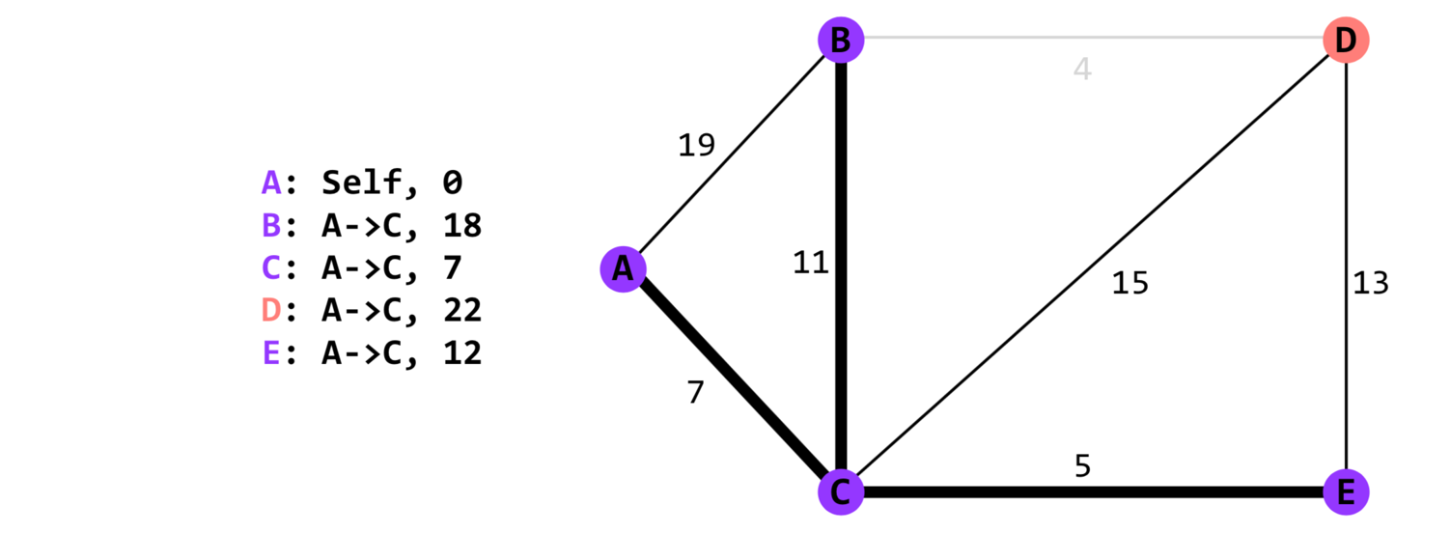
Link-state Routing

Slide 25
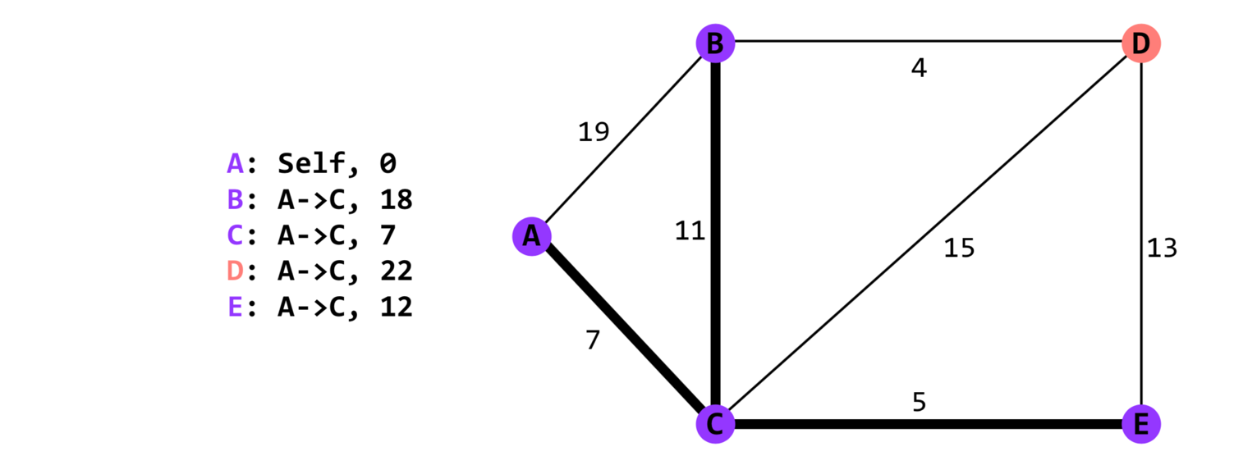
Link-state Routing

Slide 26
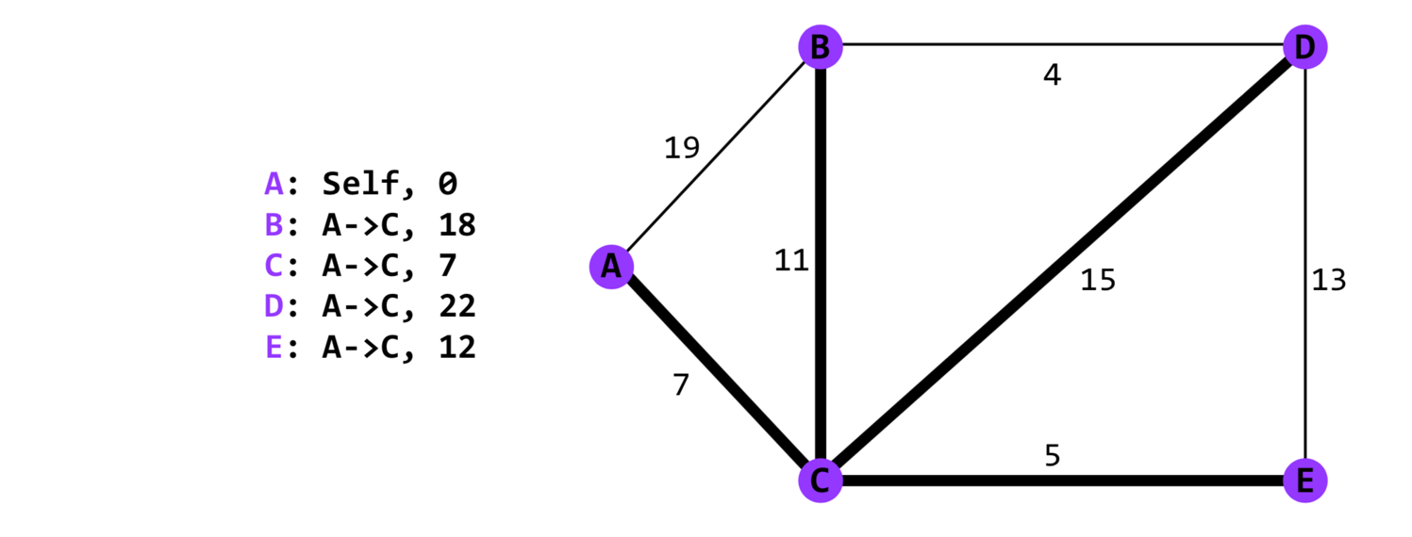
Link-state Routing

Slide 27
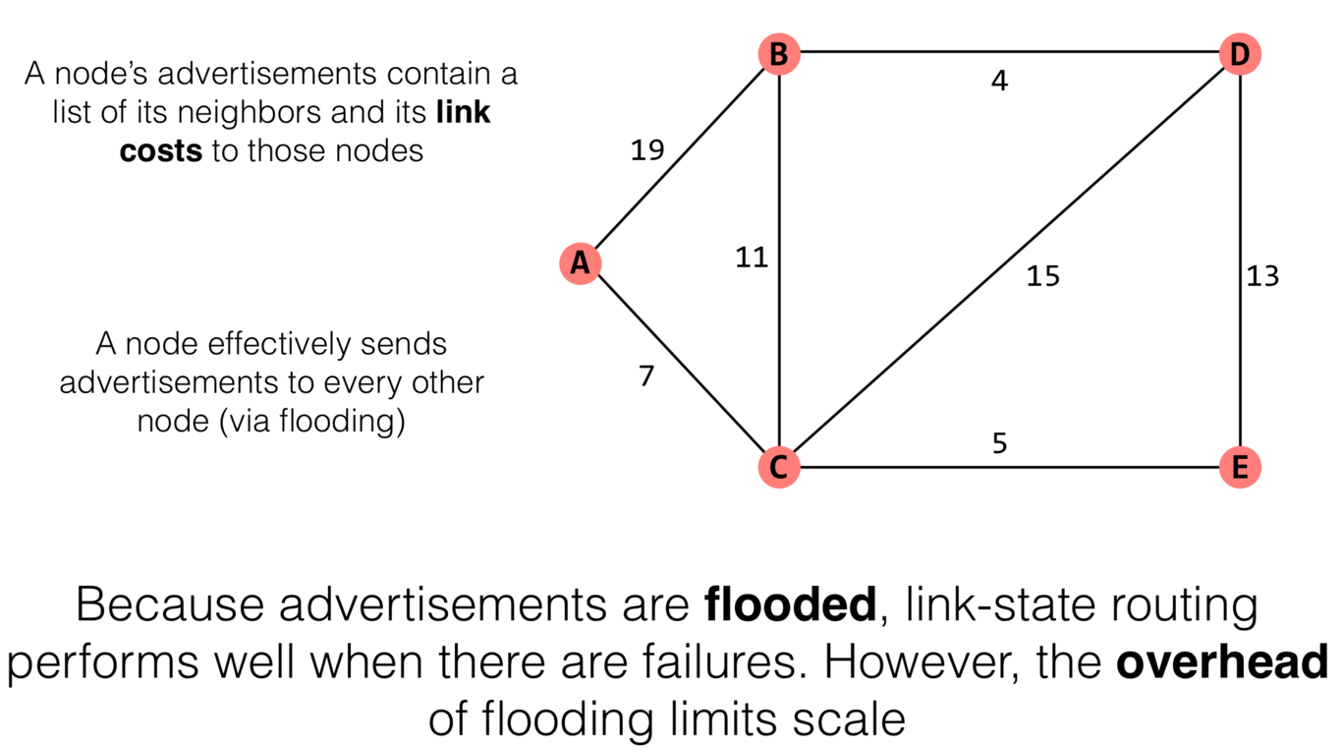
Link-state Routing

Slide 28
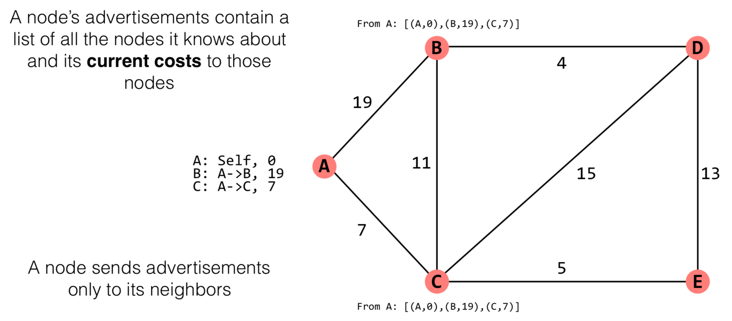
Distance-vector Routing

Slide 29
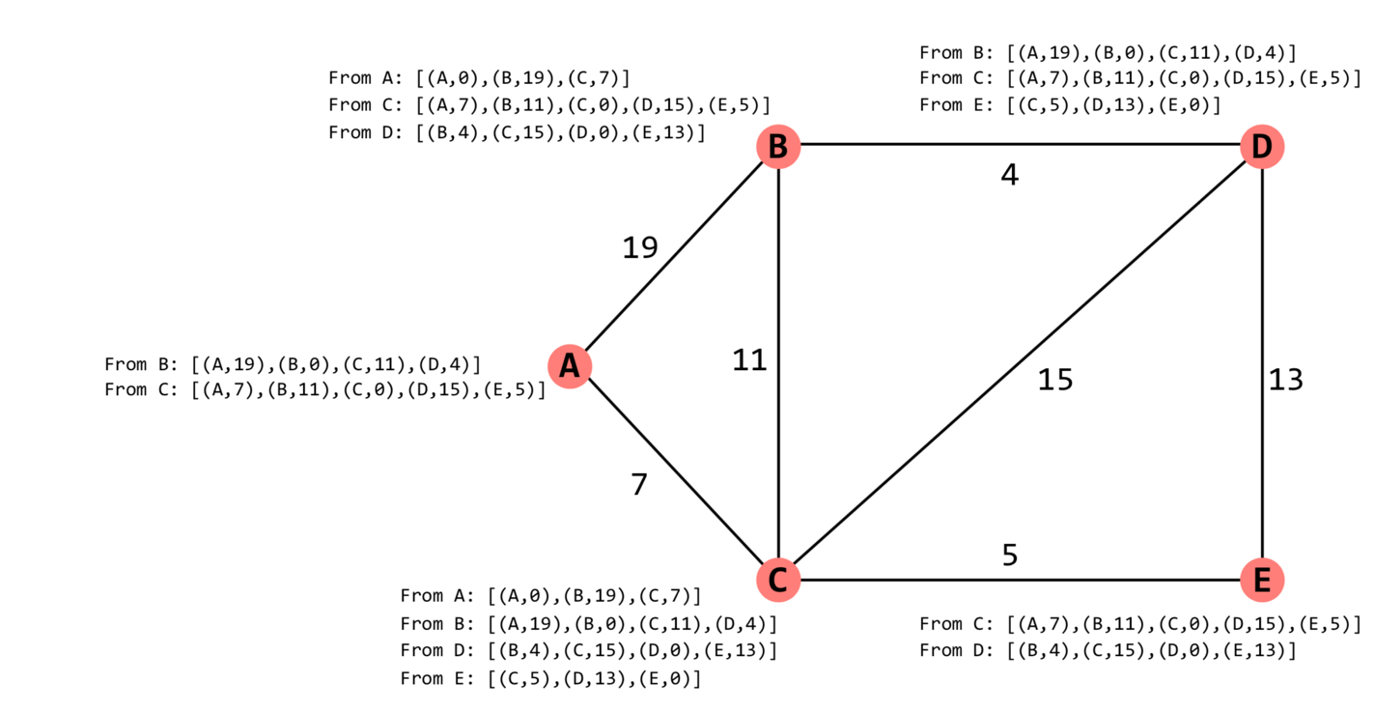
Distance-vector Routing

Slide 30
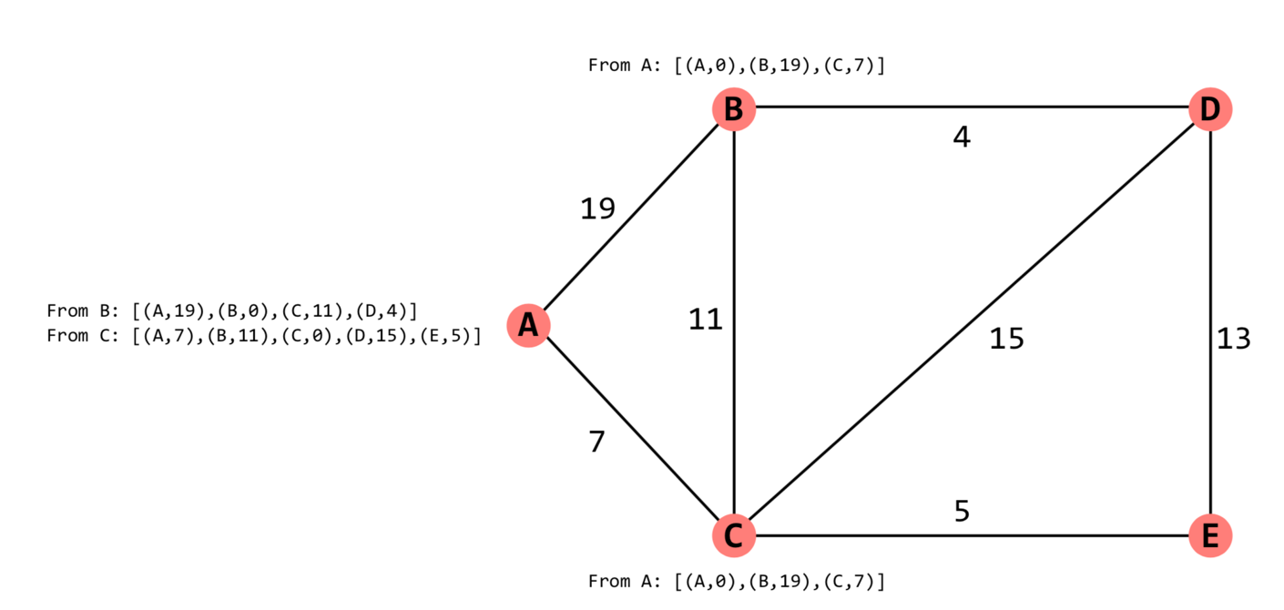
Distance-vector Routing

Slide 31
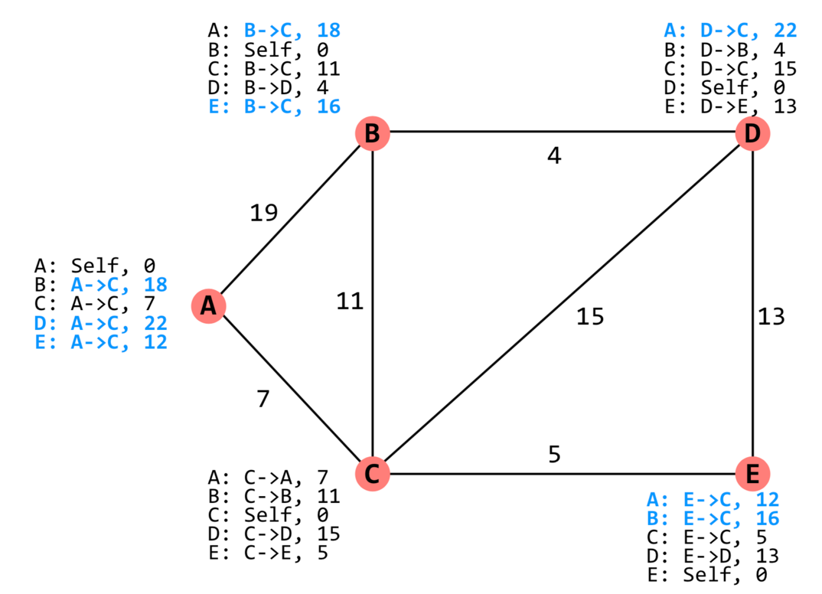
Distance-vector Routing

Slide 32
Problem: Do not Scale to the Internet
Link-State
Pro: Fast convergence
Cons: high overhead because of flooding
Good for SJTU-sized networks, but not the Internet
Distance Vector
Pro: Low overhead
Cons: Convergence time is proportional to longest path
Good for small networks

Slide 33
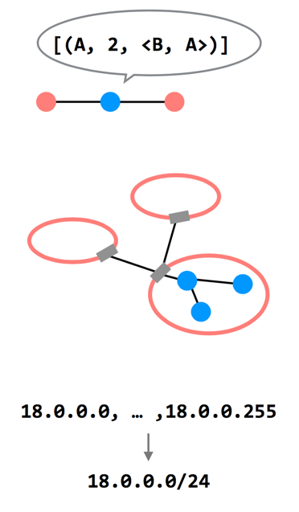
3 Ways to Scale
Path-vector Routing
Advertisements include the path, to better detect routing loops
Hierarchy of Routing
Route between regions, and then within a region
Topological Addressing
Assign addresses in contiguous blocks to make advertisements smaller

Slide 34
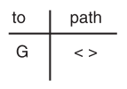
Path Vector Exchange
Each participant maintains a path vector
A complete path to some destination
E.g., zero-length path to itself
Gradually learns about other paths
Construct a new forwarding table from its new path vector
Algorithm
Advertising
Path selection

Slide 35
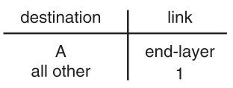
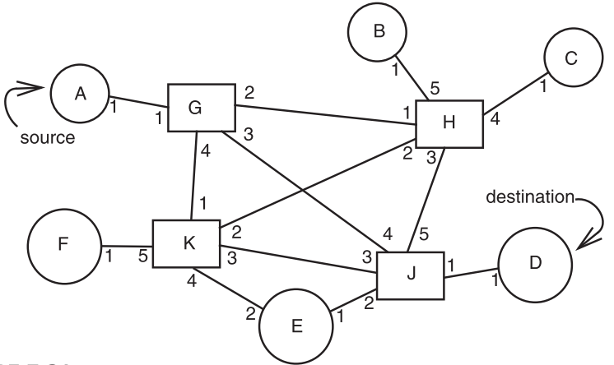
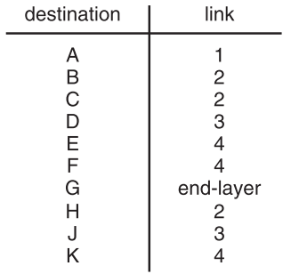
Path Vector Exchange
A
G
Need coordination to ensure no loop

Slide 36
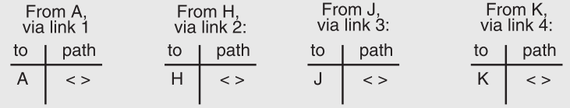
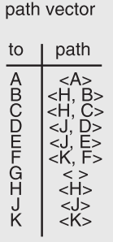
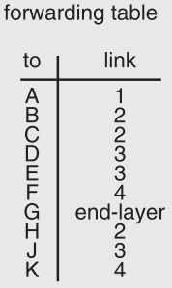
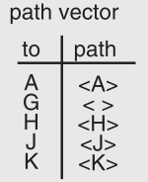
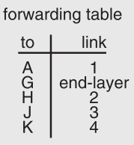
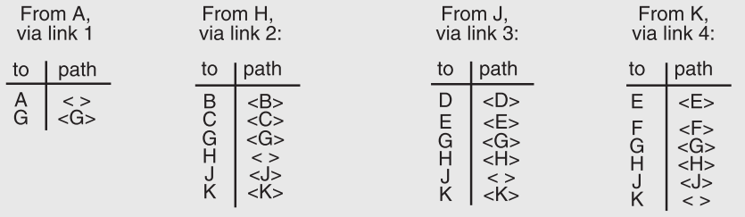

Slide 37
Path Vector Exchange
Better for scaling
Like Distance-Vector, but include the full path in the routing advertisements
Overhead increases (advertises are larger), but convergence time decreases (avoid counting to infinity)
Overhead is still lower than Link-State

Slide 38
Question on Path Vector
How do we avoid permanent loops?
When a node updates its paths, it never accepts a path that has itself
What happens when a node hears multiple paths to the same destination?
It picks the better path
What happens if the graph changes?
Algorithm deals well with new links
To deal with links that go down, each router should discard any path that a neighbor stops advertising

Slide 39
Hierarchical Address Assignment & Routing
Two problems of the path vector implementation
Every attachment point must have a unique address
The path vector grows in size with the number of attachment points
Hierarchy for better scalability
Two parts of network address: region & station, e.g., "11,75"
Regions correspond to the set of closely-connected entities
E.g., region-11 has only 1 entry in other region routers' table

Slide 40
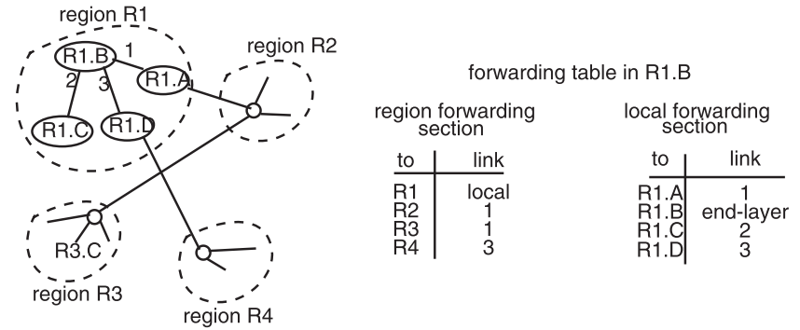
Hierarchical Address Assignment & Routing
Region is also as known as AS: Autonomous System

Slide 41
Hierarchical Address Assignment & Routing
Problems introduced by hierarchy: more complex
Binding address with location
Has to change address after changing location
Paths may no longer be the shortest possible
Algorithm has less detailed information
More about hierarchy
Can extend to more levels
Different places can have different levels

Slide 42
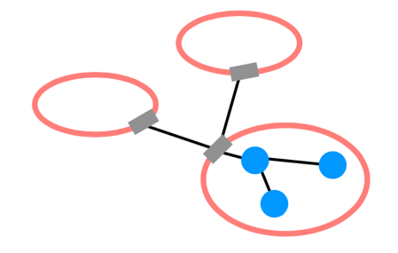
Routing Hierarchy
Across Region
Use one routing protocol to route across regions, and a different protocol to route within regions
Implies that there are devices on the edge of each region that can "translate" between or "speak" both protocols
BGP is the path-vector protocol used across regions
Border Gateway Protocol

Slide 43
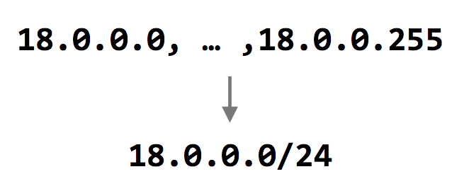
Topological Addressing
Further reduce the routing table
Despite being between regions, BGP still routes to IP addresses (e.g., to 18.0.0.1, not to region-3 )
Addresses are given to regions in contiguous blocks, so that they can be specified succinctly via a particular notation ("CIDR" notation)
CIDR: Classless Inter Domain Routing
Keeps advertisements small
CIDR Notation

Slide 44
Data Plane: Packet Forwarding

Slide 45
Network Layer Interface
structure packet
bit_string source
bit_string destination
bit_string end_protocol
bit_string payload

Slide 46
1 procedure NETWORK_SEND (segment_buffer, destination,
2 net_protocol, end_protocol)
3 packet instance outgoing_packet
4 outgoing_packet.payload ← segment_buffer
5 outgoing_packet.end_protocol ← end_protocol
6 outgoing_packet.source ← MY_NETWORK_ADDRESS
7 outgoing_packet.destination ← destination
8 NETWORK_HANDLE (outgoing_packet, net_protocol)
9 procedure NETWORK_HANDLE (net_packet, net_protocol)
10 packet instance net_packet
11 if net_packet.destination != MY_NETWORK_ADDRESS then
12 next_hop ← LOOKUP (net_packet.destination, forwarding_table)
13 LINK_SEND (net_packet, next_hop, link_protocol, net_protocol)
14 else
15 GIVE_TO_END_LAYER (net_packet.payload,
16 net_packet.end_protocol, net_packet.source)

Slide 47
GIVE_TO_END_LAYER
NETWORK_SEND
GIVE_TO_NETWORK
_HANDLER
net_handler[]
struct packet
source
destination
end_protocol
payload
NETWORK_HANDLE
LOOKUP
LINK_SEND
LINK_RECEIVE
struct frame
struct checked_cnt
net_protocol
payload
checksum
link_protocol[]
sendproc
sendproc

Slide 48
Forwarding an IP Packet
Lookup packet's DST in forwarding table
If known, find the corresponding outgoing link
If unknown, drop packet
Decrement TTL (Time To Live)
Drop packet if TTL is zero
Update header checksum
Forward packet to outgoing port
Transmit packet onto link

Slide 49
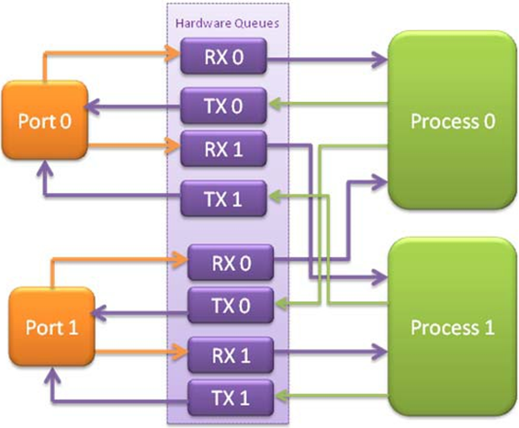
Data-plane Case Study: Intel's DPDK
DPDK: Data Plane Development Kit
Network card
Has several ports
A port has RX/TX
Processor
Read packets from RX
Polling
Find output port
Write packets to TX
RX for receiving
TX for sending

Slide 50
NAT

Slide 51
NAT (Network Address Translation)
Private network
Public routers don't accept routes to network 10
NAT router: bridge the private networks
Router between private & public network
Send: modify source address to temp public address
Receive: modify back by looking mapping table
Limitations
Some end-to-end protocols place address in payloads
The translator may become the bottleneck
What if two private network merge?

Slide 52
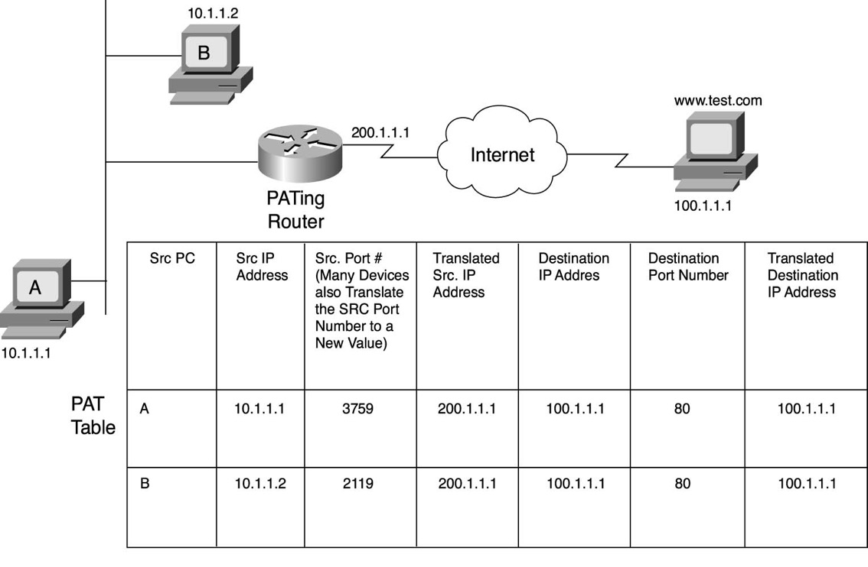
NAT

Slide 53
NAT (Network Address Translation)
Private network
Public routers don't accept routes to network 10
NAT router: bridge the private networks
Router between private & public network
Send: modify source address to temp public address
Receive: modify back by looking mapping table
Limitations
Some end-to-end protocols place address in payloads
The translator may become the bottleneck
What if two private network merge?

Slide 54


Src IP: 192.168.1.2
Src IP: 202.120.40.85
Dst IP: 173.194.72.104
Dst IP: 173.194.72.104
Src Port: 54321
Src Port: 60001
Dst Port: 80
Dst Port: 80
Data
Data
Netgate
192.168.1.2
192.168.1.1
202.120.40.85
173.194.72.104
Src IP: 173.194.72.104
Src IP | Src Port | NAT Port
192.168.1.2 | 54321 | 60001
192.168.1.2 | 12345 | 60002
...
Src IP: 173.194.72.104
Dst IP: 192.168.1.2
Dst IP: 202.120.40.85
Src Port: 80
Src Port: 80
Dst Port: 54321
Dst Port: 60001
Data
Data

Slide 55
CASE: Ethernet Mapping
Mapping Internet to Ethernet

Slide 56
Case Study: Mapping Internet to Ethernet
Listen-before-sending rule, collision
Ethernet: CSMA/CD
Carrier Sense Multiple Access with Collision Detection
Ethernet type
Experimental Ethernet, 3 mpbs
Standard Ethernet, 10 mbps
Fast Ethernet, 100 mbps
Gigabit Ethernet, 1000 mbps
Notes:
基带冲突检测的载波监听多路访问技术(载波监听多点接入/碰撞检测)

Slide 57
Overview of Ethernet
A half duplex Ethernet
The max propagation time is less than the 576 bit times, the shortest allowable packet
So that two parties can detect a collision together
If collision: wait random first time, exponential backoff if repeat
A full duplex & point-to-point Ethernet
No collisions & the max length of the link is determined by the physical medium

Slide 58
Difference between Hub and Switch
Hub
A frame is "broadcast" to every one of its ports
A 10/100Mbps hub must share its bandwidth with each port
Switch
Keeps a record of the MAC addresses of all the devices
A 10/100Mbps switch will allocate a full 10/100Mbps to each of its ports

Slide 59
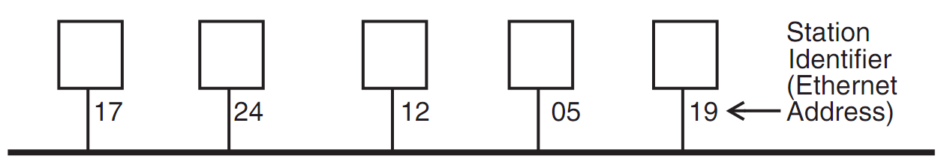
Broadcast Aspects of Ethernet
Broadcast network
Every frame is delivered to every station
(Compare with forwarding network)
ETHERNET_SEND
Pass the call along to the link layer
ETHERNET_HANDLE
Simple, can even be implemented in hardware

Slide 60
Broadcast Aspects of Ethernet
procedure ETHERNET_HANDLE (net_packet, length)
destination ← net_packet.target_id
if destination = my_station_id
then
GIVE_TO_END_LAYER (net_packet.data,
net_packet.end_protocol,
net_packet.source_id)
else
ignore packet
no need to do any forwarding

Slide 61
Broadcast Aspects of Ethernet
procedure ETHERNET_HANDLE (net_packet, length)
destination ← net_packet.target_id
if destination = my_station_id
or destination = BROADCAST_ID
then
GIVE_TO_END_LAYER (net_packet.data,
net_packet.end_protocol,
net_packet.source_id)
else
ignore packet

Slide 62
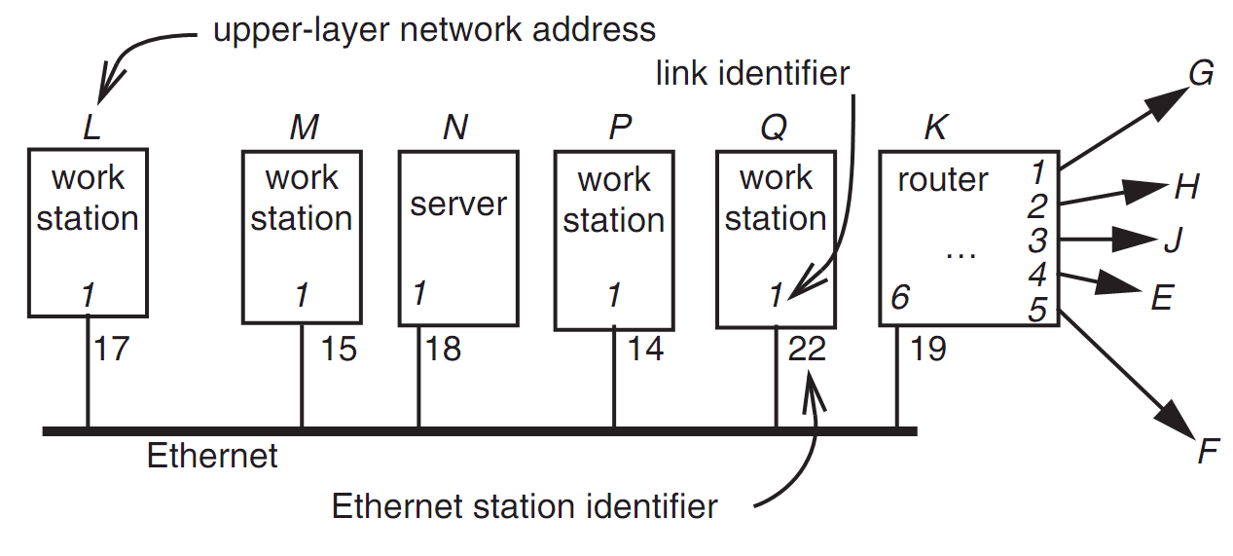
Layer Mapping: Attach Ethernet to Forwarding Network
15
L sends a RPC to N by sending to station 18 of link 1
L sends a RPC to E by sending to K, E may have 15 as address, as well as M

Slide 63
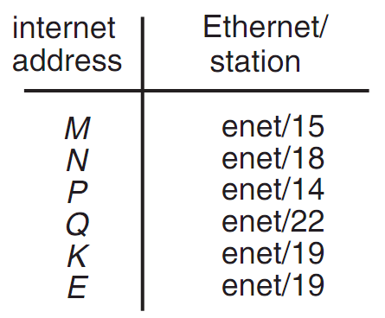
Layer Mapping
The Internet network layer
NETWORK_SEND (data, length, RPC, INTERNET, N)
NETWORK_SEND (data, length, RPC, ENET, 18)
L must maintain a table

Slide 64
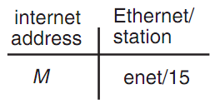
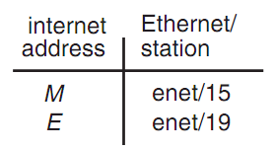
ARP (Address Resolution Protocol)
NETWORK_SEND ("where is M?", 11, ARP, ENET, BROADCAST)
NETWORK_SEND ("M is at station 15", 18, ARP, ENET, BROADCAST)
L asks E's Ethernet address, E does not hear the Ethernet broadcast, but the router at station 19 does, and it sends a suitable ARP response instead
Manage forwarding table as a cache

Slide 65
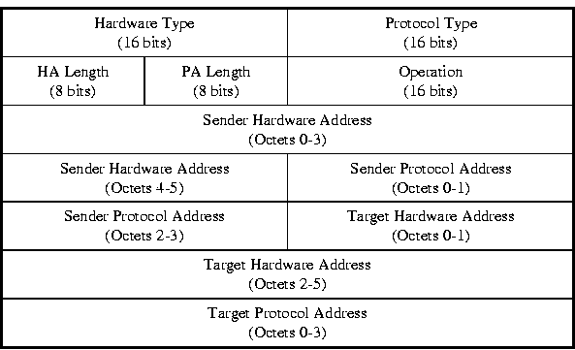
ARP & RARP Protocol
Name mapping: IP address <-> MAC address

Slide 66
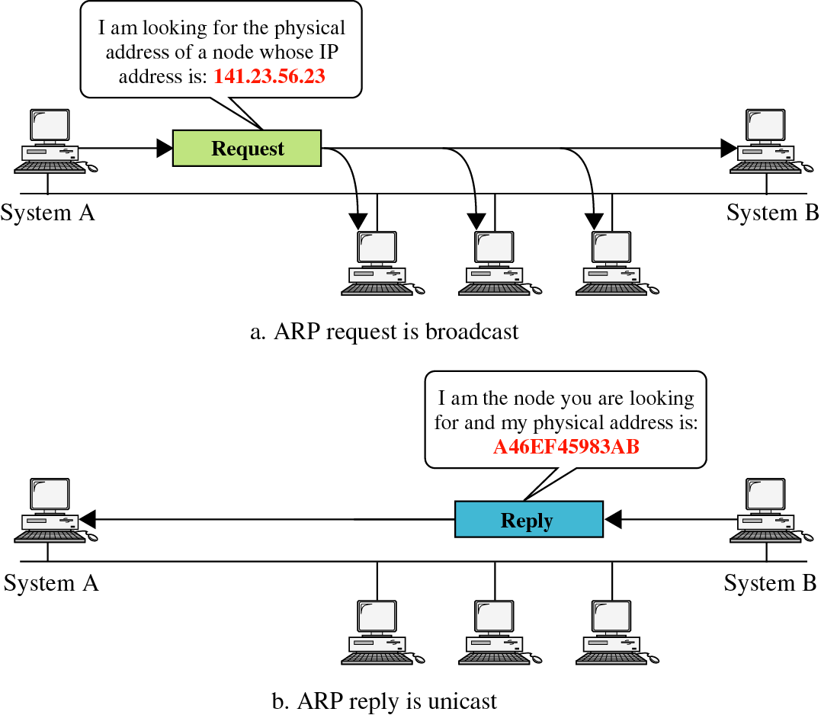
ARP & RARP

Slide 67
Network Topology
Take SJTU network for example
Subnet: usually like 192.168.0.2 or 10.0.0.2
Gateway: usually like 192.168.0.1
Get the global IP address: 202.120.40.82
A gateway usually has two (or more) IP address
Proxy: get proxy's address
E.g., 106.185.46.164 (Japan)

Slide 68
Network Topology
Baidu
192.168.0.2
A
192.168.0.3
B
220.181.57.217
G
Google
192.168.0.4
C
Gateway
Proxy
192.168.0.1
202.120.40.82
106.185.46.164
173.194.38.198

Slide 69
How to Use socket to Access www.baidu.com ?
You code as if your PC connect directly with Baidu
Call connect() with Baidu's IP address
But how does the system find next hop?
C
Baidu
192.168.0.4
220.181.57.217

Slide 70
Putting All Together
App: I want to send a packet to Baidu, here is the packet with Baidu's IP in its header as target IP, and client's IP as source IP (Node-C)
OS: I don't know how to get to Baidu, I'll just send it to the router (gateway). But I cannot change the source IP of the packet, so I'll just change the MAC target address of the packet to the router's MAC address
Target MAC:
Source MAC:
Target IP: Baidu's IP
Source IP: Node-C
Data
Target MAC: Gateway
Source MAC: Node-C
Target IP: Baidu's IP
Source IP: Node-C
Data

Slide 71
Putting All Together
Target MAC: Gateway
The router-1 (gateway): I get a packet with my MAC as target address. Is it my IP? No… So I'll just forward it to next hop, by changing the target MAC address to next hop's MAC address (NAT: change source IP and source port as well)
Router-2: I connect directly to Baidu, I'll just change the target MAC address to Baidu
Source MAC: Node-C
Target IP: Baidu's IP
Source IP: Node-C
Data
Target MAC: Router-2
Source MAC: Router-1
Target IP: Baidu's IP
Source IP: Router-1
Data
Target MAC: Baidu
Source MAC: Router-2
Target IP: Baidu's IP
Source IP: Router
Data

Slide 72
ARP Spoofing
Construct spoofed ARP replies
A target computer could be convinced to send frames destined for computer A to instead go to computer B
Computer A will have no idea that this redirection took place
This process of updating a target computer's ARP cache is referred to as "ARP poisoning"

Slide 73
Spoofed ARP reply
IP:10.0.0.2
MAC:cc:cc:cc:cc
Spoofed ARP reply
IP:10.0.0.2
MAC:cc:cc:cc:cc
switch
Spoofed ARP reply
IP:10.0.0.2
MAC:cc:cc:cc:cc
A
IP:10.0.0.1
MAC:aa:aa:aa:aa
B
IP:10.0.0.2
MAC:bb:bb:bb:bb
Hacker
IP:10.0.0.3
MAC:cc:cc:cc:cc
ARP cache
ARP cache
IP | MAC
10.0.0.2 | bb:bb:bb:bb
IP | MAC
10.0.0.1 | aa:aa:aa:aa

Slide 74
switch
A
IP:10.0.0.1
MAC:aa:aa:aa:aa
B
IP:10.0.0.2
MAC:bb:bb:bb:bb
Hacker
IP:10.0.0.3
MAC:cc:cc:cc:cc
A's cache is poisoned
ARP cache
ARP cache
IP | MAC
10.0.0.2 | cc:cc:cc:cc
IP | MAC
10.0.0.1 | aa:aa:aa:aa

Slide 75
ARP Spoofing
Now all the packets that A intends to send to B will go to the hacker's machine
Cache entry would expire, so it needs to be updated by sending the ARP reply again
How often?
depends on the particular system
Usually every 40s should be sufficient
In addition the hacker may not want his Ethernet driver talk too much
Accomplish with ifconfig -arp

Slide 76
Man-in-the-Middle Attack
A hacker inserts his computer between the communications path of two target computers
The hacker will forward frames between the two target computers so communications are not interrupted
E.g., Hunt, Ettercap, etc.
Can be obtained easily in many web archives

Slide 77
Man-in-the-Middle Attack
The attack is performed as follows:
Suppose X is the hacker's computer
T1 and T2 are the targets
X poisons the ARP cache of T1 and T2
T1 associates T2's IP with X's MAC
T2 associates T1's IP with X's MAC
All of T1 and T2's traffic will then go to X first, instead of directly to each other

Slide 78
Spoofed ARP reply
IP:10.0.0.2
MAC:cc:cc:cc:cc
Spoofed ARP reply
IP:10.0.0.2
MAC:cc:cc:cc:cc
switch
Spoofed ARP reply
IP:10.0.0.2
MAC:cc:cc:cc:cc
T1
IP:10.0.0.1
MAC:aa:aa:aa:aa
T2
IP:10.0.0.2
MAC:bb:bb:bb:bb
Hacker
IP:10.0.0.3
MAC:cc:cc:cc:cc
ARP cache
ARP cache
IP | MAC
10.0.0.2 | bb:bb:bb:bb
IP | MAC
10.0.0.1 | aa:aa:aa:aa

Slide 79
switch
T1
IP:10.0.0.1
MAC:aa:aa:aa:aa
T2
IP:10.0.0.2
MAC:bb:bb:bb:bb
Hacker
IP:10.0.0.3
MAC:cc:cc:cc:cc
ARP cache
ARP cache
IP | MAC
10.0.0.2 | cc:cc:cc:cc
IP | MAC
10.0.0.1 | aa:aa:aa:aa
T1's cache is poisoned

Slide 80
Forged ARP replies
IP:10.0.0.1
MAC:cc:cc:cc:cc
switch
Forged ARP replies
IP:10.0.0.1
MAC:cc:cc:cc:cc
T1
IP:10.0.0.1
MAC:aa:aa:aa:aa
T2
IP:10.0.0.2
MAC:bb:bb:bb:bb
Hacker
IP:10.0.0.3
MAC:cc:cc:cc:cc
ARP cache
ARP cache
IP | MAC
10.0.0.2 | cc:cc:cc:cc
IP | MAC
10.0.0.1 | aa:aa:aa:aa

Slide 81
switch
T1
IP:10.0.0.1
MAC:aa:aa:aa:aa
T2
IP:10.0.0.2
MAC:bb:bb:bb:bb
Hacker
IP:10.0.0.3
MAC:cc:cc:cc:cc
ARP cache
ARP cache
IP | MAC
10.0.0.2 | cc:cc:cc:cc
IP | MAC
10.0.0.1 | cc:cc:cc:cc
T2's cache is poisoned

Slide 82
Message intended to send to T2
switch
Hacker will
relay the
message
T1
IP:10.0.0.1
MAC:aa:aa:aa:aa
T2
IP:10.0.0.2
MAC:bb:bb:bb:bb
Hacker
IP:10.0.0.3
MAC:cc:cc:cc:cc
ARP cache
ARP cache
IP | MAC
10.0.0.2 | cc:cc:cc:cc
IP | MAC
10.0.0.1 | cc:cc:cc:cc

Slide 83
Hacker will relay the message
switch
Message
intended to
send to T1
T1
IP:10.0.0.1
MAC:aa:aa:aa:aa
T2
IP:10.0.0.2
MAC:bb:bb:bb:bb
Hacker
IP:10.0.0.3
MAC:cc:cc:cc:cc
ARP cache
ARP cache
IP | MAC
10.0.0.2 | cc:cc:cc:cc
IP | MAC
10.0.0.1 | cc:cc:cc:cc

Slide 84
Defenses against ARP Spoofing
No Universal defense (!)
Use static ARP entries
Cannot be updated
Spoofed ARP replies are ignored
ARP table needs a static entry for each machine on the network
Large overhead
Deploying these tables
Keep the table up-to-date

Slide 85
Arpwatch
A free UNIX program which listens for ARP replies on a network
Build a table of IP/MAC associations and store it in a file
When a MAC/IP pair changes (flip-flop), an email is sent to an administrator
Some programs, such as Ettercap, cause only a few flip flops is difficult to be detected on a DHCP-enabled network, where flip flops occur at regular intervals

